Slide 1
Unit 7:Optimizing E-commerce Systems

Slide 2
Search Engine Optimization(SEO)
SEO is the process of optimizing web pages and their content to be easily discoverable by users searching for terms relevant to your website.
• The term SEO also describes the process of making web pages easier for search engine indexing software, known as "crawlers," to find, scan, and index your site

Slide 3
• Many people search for specific products and services with the intent to pay for these things.
• These searches are known to have commercial intent, meaning they are clearly indicating with their search that they want to buy something you offer.

Slide 4
It’s important to note that Google is responsible for the majority of the search engine traffic in the world.
This may vary from one industry to another, but it’s likely that Google is the dominant player in the search results that your business or website would want to show up in

Slide 5
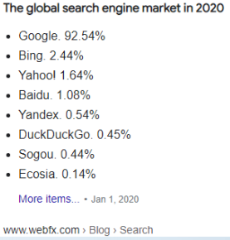

Slide 6
Working mechanism of Search Engines
Search engines work by crawling hundreds of billions of pages using their own web crawlers.
• These web crawlers are commonly referred to as search engine bots or spiders.
• A search engine navigates the web by downloading web pages and following links on these pages to discover new pages that have been made available

Slide 7
Web pages that have been discovered by the search engine are added into a data structure called an index

Slide 8
The index includes all the discovered URLs along with a number of relevant key signals about the contents of each URL such as
– The keywords discovered within the page’s content – what topics does the page cover?
– The type of content that is being crawled (using microdata called Schema) – what is included on the page?
– The freshness of the page – how recently was it updated?
– The previous user engagement of the page and/or domain – how do people interact with the page?

Slide 9
Aim of a Search Engine Algorithm
The aim of the search engine algorithm is to present a relevant set of high quality search results that will fulfill the user’s query/question as quickly as possible.
• The user then selects an option from the list of search results and this action, along with subsequent activity, then feeds into future learnings which can affect search engine rankings going forward.

Slide 10
When a search query is entered into a search engine by a user, all of the pages which are considered to be relevant are identified from the index and an algorithm is used to hierarchically rank the relevant pages into a set of results.
• The algorithms used to rank the most relevant results differ for each search engine.
• For example, a page that ranks highly for a search query in Google may not rank highly for the same query in Bing.

Slide 11
In addition to the search query, search engines use other relevant data to return results, including :
– Location : Some search queries are location-dependent.
– Language detected : Search engines will return results in the language of the user, if it can be detected.
– Previous search history : Search engines will return different results for a query dependent on what user has previously searched for.
– Device : A different set of results may be returned based on the device from which the query was made.

Slide 12
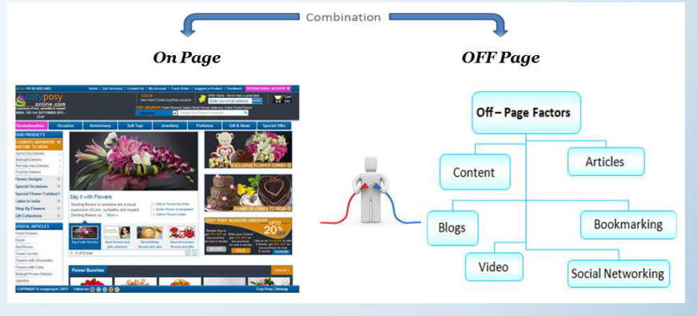
On-page Vs Off-page SEO

Slide 13
On-page SEO
On-page SEO is the practice of optimizing individual web pages in order to rank higher and earn more relevant traffic in search engines.
• On-page refers to both the content and HTML source code of a page that can be optimized, as opposed to off-page SEO which refers to links and other external signals

Slide 14
Common on-page SEO practices include optimizing title tags, content, internal links and URLs.
• The most basic signal that information is relevant is when a webpage contains the same keywords as your search query.
• If those keywords appear on the page, or if they appear in the headings or body of the text, the information is more likely to be relevant.

Slide 15
Off-page SEO
“Off-Page SEO” refers to all of the activities that you and others do away from your website to raise the ranking of a page with search engines
• Though many people associate off-page SEO with link building, it goes beyond that.
• Many activities that don’t result in a standard link on other sites are important for off-page optimization

Slide 16
On-page search engine optimization happens within the site, while off-page SEO happens outside the site
• If you write a guest post for another blog or leave a comment, you’re doing off-page site promotion
• Off-page SEO simply tells Google what others think about your site.
• For example, if you’ve got a lot of valuable links pointing to your pages, search engines will assume that you’ve got great content – the type that provides value for users

Slide 17
Page Ranks
Page Rank(PR) is an algorithm used by Google Search Engine to rank web pages in their search engine results.
• Page Rank was named after Larry Page, one of the founders of Google.
• Page Rank is a way of measuring the importance of website pages.

Slide 18
According to Google, “Page Rank works by counting the number and quality of links to a page to determine a rough estimate of how important the website is. The underlying assumption is that more important websites are likely to receive more links from other websites”
• Currently, Page Rank is not the only algorithm used by Google to order search results, but it is the first algorithm that was used by the company, and it is the best known.
• As of September 24, 2019, PageRank and all associated patents are expired.

Slide 19
Recommendation System
Types
Collaborative Recommender System
Content based Recommender System

Slide 20
Collaborative Recommender System
It is most widely implemented and most mature technologies that is available in the market.
– Collaborative recommender systems aggregate ratings or recommendations of objects, recognize commonalities between the users on the basis of their ratings, and generate new recommendations based on inter-user comparisons.

Slide 21
– The greatest strength of collaborative techniques is that they are completely independent of any machine-readable representation of the objects being recommended and work well for complex objects where variations in taste are responsible for much of the variation in preferences.
– Collaborative filtering is based on the assumption that people who agreed in the past will agree in the future and that they will like similar kind of objects as they liked in the past.
– Examples : Amazon, YouTube, and Netflix

Slide 22
Content based Recommender System
It’s mainly classified as an outgrowth and continuation of information filtering research.
– In this system, the objects are mainly defined by their associated features.
– A content-based recommender learns a profile of the new user’s interests based on the features present, in objects the user has rated.

Slide 23
– It’s basically a keyword specific recommender system here keywords are used to describe the items.
– Thus, in a content-based recommender system the algorithms used are such that it recommends users similar items that the user has liked in the past or is examining currently
– Examples : Social medias, youtube

Slide 24
Use of Recommendation Systems in E-commerce
Recommender systems allow rapid and automated customization and personalization of e-commerce sites.
• They allow the sites to generate more sales by tailoring to the needs of the visitors and turning them into consumers, up-selling extra products by bundling closely related things together, and increasing customer loyalty
• Customer loyalty is achieved by showing customers that they take time to understand their needs and to learn more about them.
• This is evident when the website structure, the products, and presentation of products changes to customers’ needs and preferences

Slide 25
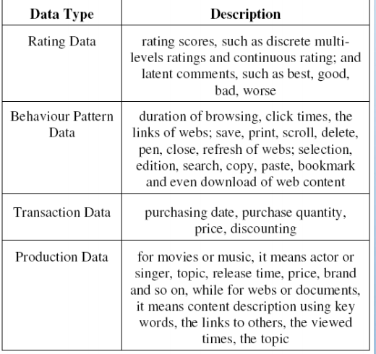
Data used in recommendation system

Slide 26
Thank You

